Slide 1


DEPARTMENT OF ELECTRONICS
ENGINEERING
SESSION:-2017-18
CAE-3
SUBJECT:- APPLIED PHYSICS
TOPIC:- HUMAN INTERFACE
SUBMITTED BY:
ANKIT-AGRAWAL(A-36)
ASHISH-PABBEWAR(B-41)
KALPESH-DHOBLE(B-43)
ADARSH-PATIL(B-46)
UNDER THE GUIDANCE OF
PROF.MUGDHA DAMBHARE MAM

Slide 2
Human interface

Slide 3
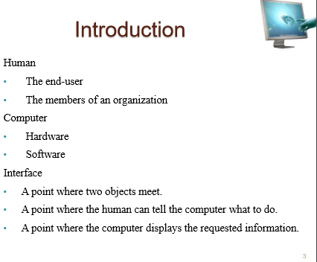

Slide 4
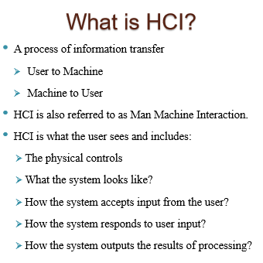

Slide 5
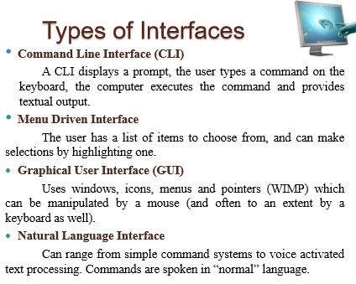

Slide 6
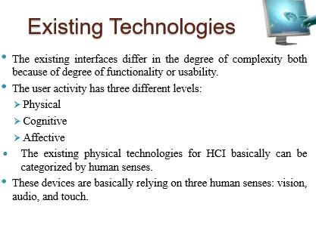

Slide 7
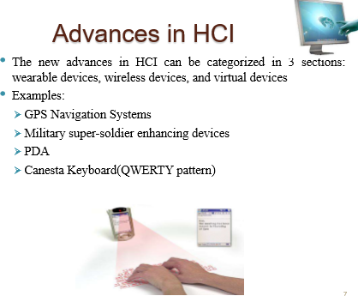

Slide 8
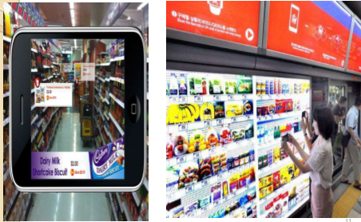
EVERY THING ON FINGURE TIPS

Slide 9
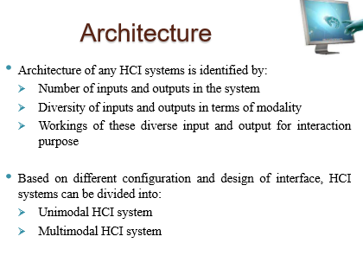

Slide 10
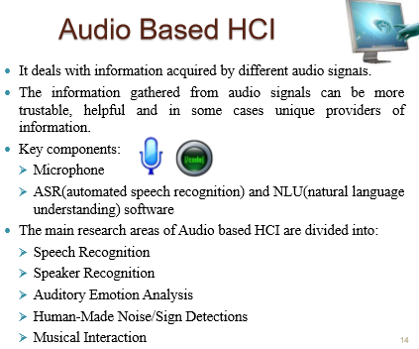

Slide 11
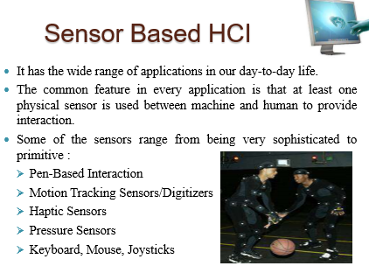

Slide 12
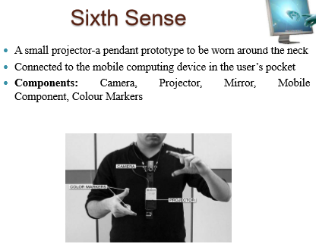

Slide 13
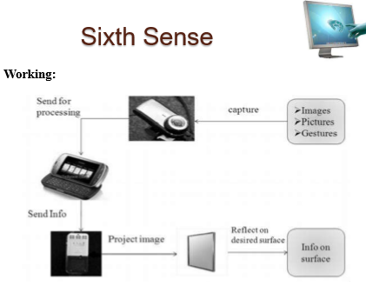

Slide 14
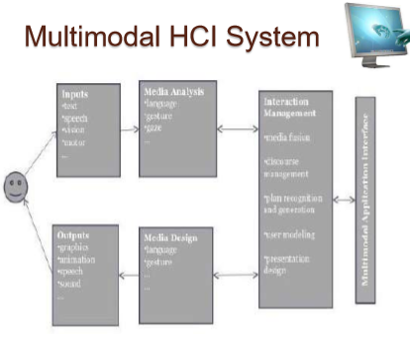

Slide 15
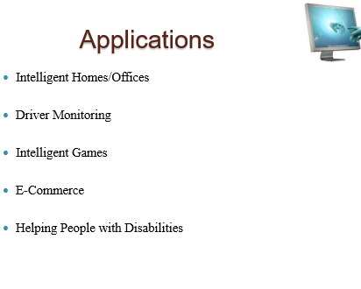

Slide 16
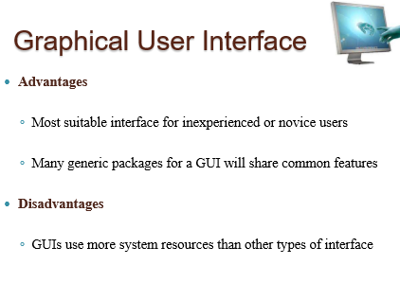

Slide 17
THANK YOU!!

